Slide 1

Advanced Python modules and functionalities
Lesson 8 – 9/30/16
Notes:
With notes!

Slide 2
Today's schedule
Advanced Modules
matplotlib – graphing and figure generation
optparse – flagged inputs
Raspberry Pi as a Learning Tool

Slide 3
1. matplotlib

Slide 4
matplotlib
Purpose: Graphing and visualization of data:
Plots
Histograms
Barplots, etc
Say goodbye to figure generation using Excel

Slide 5
Example matplotlib
Problem:
You want to plot the expression of YFG over five different time points in your dataset. You want to also to compare this time course to that of YFHKG.

Slide 6
Example: Plotting Lines
%matplotlib inline
import matplotlib.pyplot as plt
days = [10, 20, 30, 40, 50]
YFG = [2500, 2600, 3000, 4000, 2455]
YFHKG = [1100, 1300, 1275, 1567, 1212]
plt.plot(days, YFG)
plt.plot(days, YFHKG)
plt.show()

Slide 7
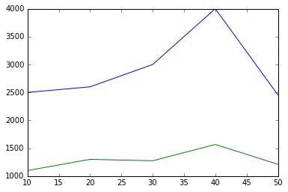
Example Result

Slide 8
Example: Labeling Axes
%matplotlib inline
import matplotlib.pyplot as plt
days = [10, 20, 30, 40, 50]
YFG = [2500, 2600, 3000, 4000, 2455]
YFHKG = [1100, 1300, 1275, 1567, 1212]
plt.plot(days, YFG)
plt.plot(days, YFHKG)
plt.xlabel("# of Days")
plt.ylabel("Gene Expression (FPKM)")
plt.title(”Expression of YFG and YFHKG Over Time")
plt.show()

Slide 9
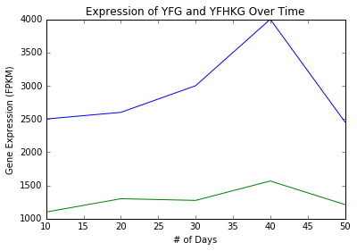
Example Result

Slide 10
Example: Changing Axes
%matplotlib inline
import matplotlib.pyplot as plt
days = [10, 20, 30, 40, 50]
YFG = [2500, 2600, 3000, 4000, 2455]
YFHKG = [1100, 1300, 1275, 1567, 1212]
plt.plot(days, YFG)
plt.plot(days, YFHKG)
plt.xlabel("# of Days")
plt.ylabel("Gene Expression (FPKM)")
plt.title(”Expression of YFG and YFHKG Over Time")
plt.axis([10,50, 0, 5000])
plt.show()

Slide 11
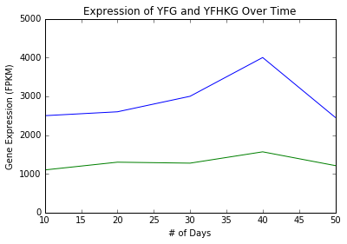
Example Result

Slide 12
Example: Changing Axes
%matplotlib inline
import matplotlib.pyplot as plt
days = [10, 20, 30, 40, 50]
YFG = [2500, 2600, 3000, 4000, 2455]
YFHKG = [1100, 1300, 1275, 1567, 1212]
plt.plot(days, YFG, label=“YFG”)
plt.plot(days, YFHKG, label=“YFHKG”)
plt.xlabel("# of Days")
plt.ylabel("Gene Expression (FPKM)")
plt.title(”Expression of YFG and YFHKG Over Time")
plt.axis([10,50, 0, 5000])
plt.legend()
plt.show()
Notes:
Note that "python argTest.py apple banana" should be run on the command line, in the same directory as the script

Slide 13
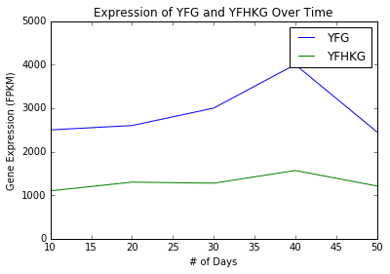
Example Result

Slide 14
Notes on matplotlib
Visualization is highly customizable
Line color, type, width
Error bars
Legend attributes
Axes attributes
Double y-axes, etc
Examples of specific types of figures and their implementation are available online
Can create beautiful figures fast
Plotting with code is impressive

Slide 15
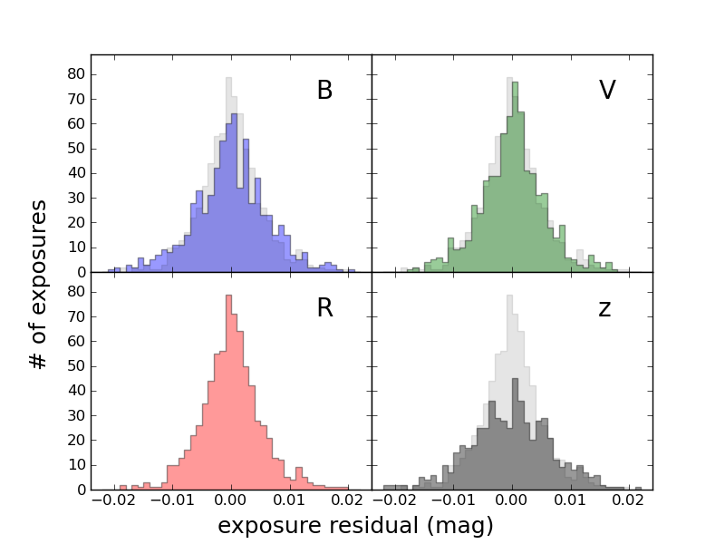
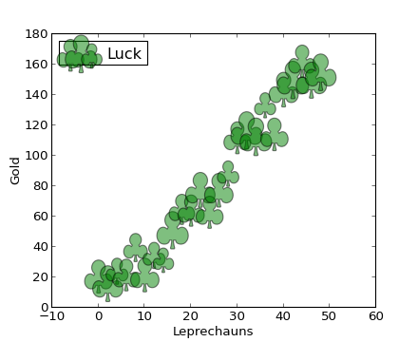
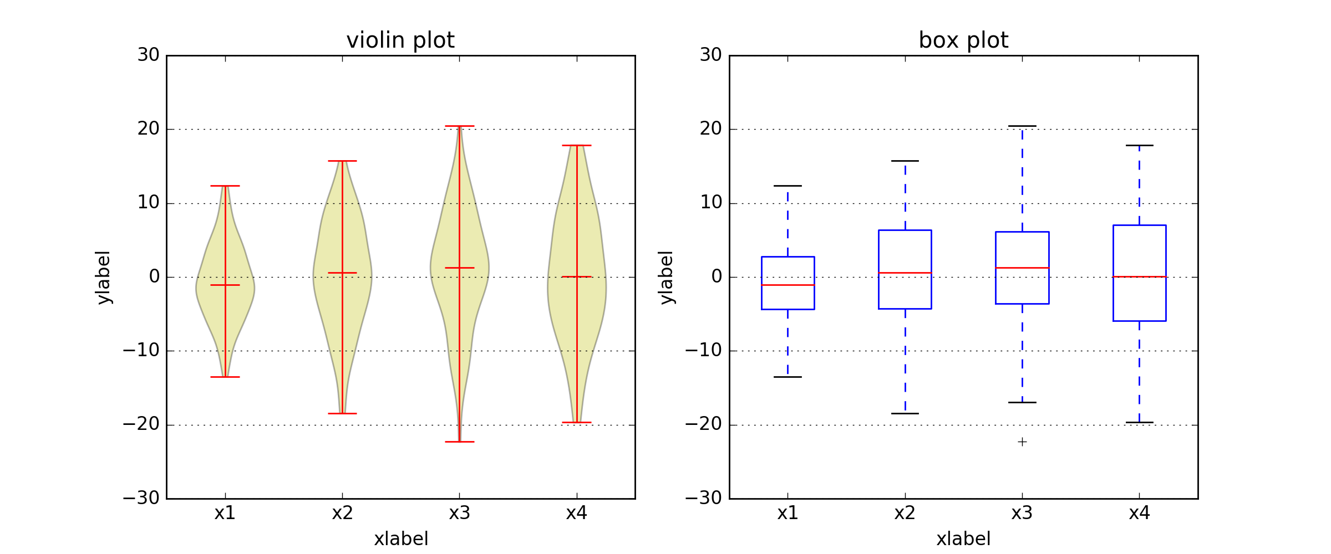
Matplotlib examples

Slide 16
2. optparse

Slide 17
optparse
Purpose: provides flagged input functionality to scripts
Input arguments can be in any order
Resulting command is human read-able
Allows the user to query input arguments and “help”

Slide 18
optparse
from optparse import OptionParser
parser = OptionParser()
parser.add_option("-f", "--file", dest="filename",
help="write report to FILE”)
parser.add_option("-q", "--quiet",
action="store_false", dest="verbose”, default=True,
help="don't print status messages")
(options, args) = parser.parse_args()

Slide 19
optparse
from optparse import OptionParser
parser = OptionParser()
parser.add_option("-f", "--file", dest="filename",
help="write report to FILE”)
parser.add_option("-q", "--quiet",
action="store_false", dest="verbose”, default=True,
help="don't print status messages")
(options, args) = parser.parse_args()

Slide 20
optparse
from optparse import OptionParser
parser = OptionParser()
parser.add_option("-f", "--file", dest="filename",
help="write report to FILE”)
parser.add_option("-q", "--quiet",
action="store_false", dest="verbose”, default=True,
help="don't print status messages")
(options, args) = parser.parse_args()

Slide 21
optparse
from optparse import OptionParser
parser = OptionParser()
parser.add_option("-f", "--file", dest="filename",
help="write report to FILE”)
parser.add_option("-q", "--quiet",
action="store_false", dest="verbose”, default=True,
help="don't print status messages")
(options, args) = parser.parse_args()

Slide 22
optparse
from optparse import OptionParser
parser = OptionParser()
parser.add_option("-f", "--file", dest="filename",
help="write report to FILE”)
parser.add_option("-q", "--quiet",
action="store_false", dest="verbose”, default=True,
help="don't print status messages")
(options, args) = parser.parse_args()

Slide 23
Example optparse
Problem:
You have a script that computes gene lengths of set a genes given an annotation file that contains genomic positions of both introns and exons. You want to include a parameter that would change the functionality to only include exons in gene length when desired.

Slide 24
optparse exmple: CDS length
from optparse import OptionParser
parser = OptionParser()

Slide 25
optparse exmple: CDS length
from optparse import OptionParser
parser = OptionParser()
parser.add_option(”-g", "--geneAnnotation", dest=”annot",
help=”UCSC gene annotation file”)

Slide 26
optparse example: CDS length
from optparse import OptionParser
parser = OptionParser()
parser.add_option(”-g", "--geneAnnotation", dest=”annot",
help=”UCSC gene annotation file”)
parser.add_option(”-c", "--coding",
action="store_true", dest=”coding”, default=False,
help=”flag to only inlude exons in gene length computation")

Slide 27
optparse exmple: CDS length
from optparse import OptionParser
parser = OptionParser()
parser.add_option(”-g", "--geneAnnotation", dest=”annot",
help=”UCSC gene annotation file”)
parser.add_option(”-c", "--coding",
action="store_true", dest=”coding”, default=False,
help=”flag to only inlude exons in gene length computation")
(options, args) = parser.parse_args()

Slide 28
optparse: interaction (help)
python compute_length.py –-help
or
python compute_length.py –-help
Usage: compute_length.py [options] arg1 arg2
Options:
-h, --help show this help message and exit
-g, --geneAnnotation UCSC gene annotation file
-c, --coding flag to only include exons in gene length computation

Slide 29
optparse: interaction (inputs)
python compute_length.py –-geneAnnotation UCSC.gtf --coding
or
python compute_length.py –g UCSC.gtf –c
Usage: compute_length.py [options] arg1 arg2
Options:
-h, --help show this help message and exit
-g, --geneAnnotation UCSC gene annotation file
-c, --coding flag to only include exons in gene length computation

Slide 30
optparse: using inputs
(options, args) = parser.parse_args()
gene_file = options.annot
if options.coding == True:
print “Exclude introns from computation”

Slide 31
3. Learning with RaspberryPi

Slide 32

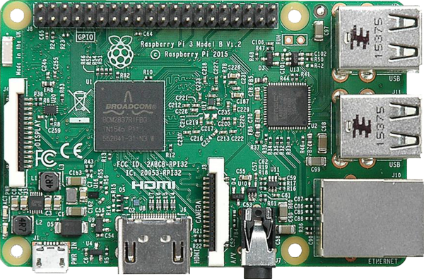

Slide 33
GPIO Pins
USB Ports
Ethernet
WiFi
Bluetooth

Slide 34
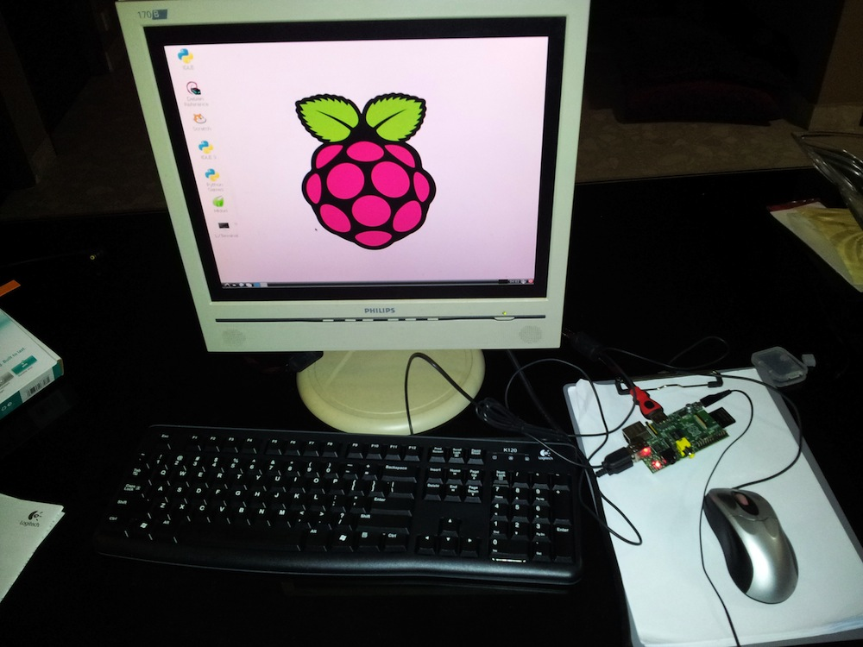

Slide 35
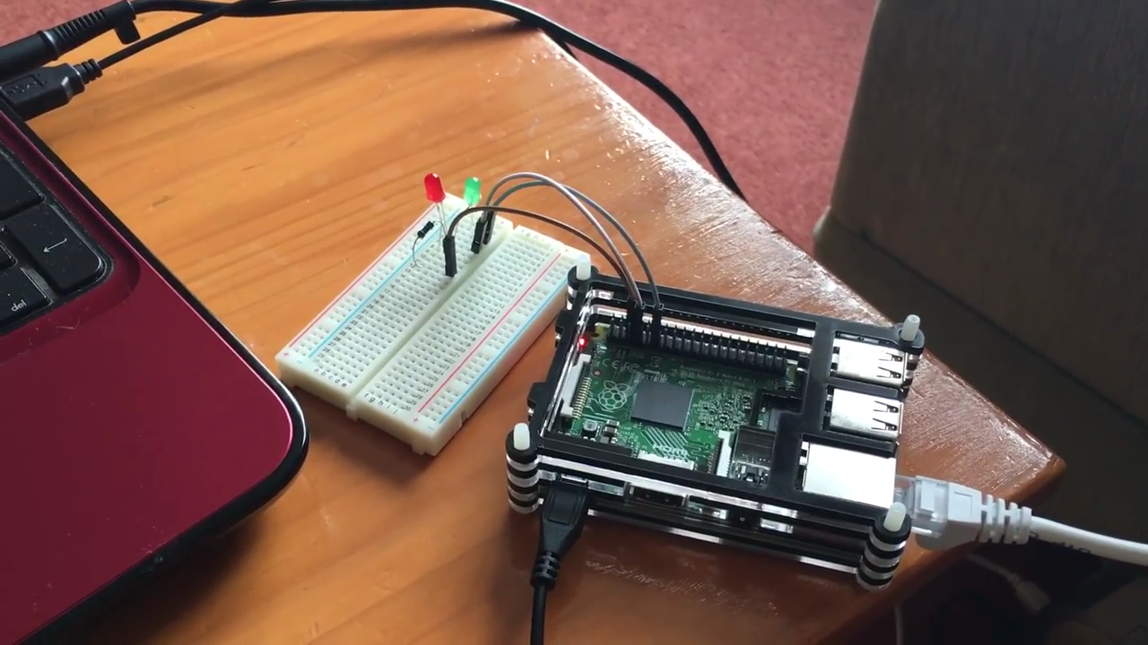
Notes:
This is a video showing a basic LED setup using the raspberry pi. Available here: https://www.youtube.com/watch?v=E5n0DGO4IwE
This is usually the first tutorial someone starting out with raspberry pi would do. Python code is used to iteratively turn on and off LEDs buying turning on and off GPIO pins.

Slide 36
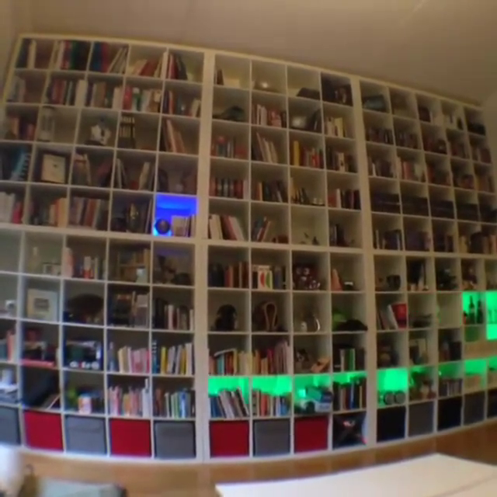
Notes:
Someone created a snake game using a raspberry pi connected to led lights hidden in each cell of his bookcase. The code for the game is a little more complex…. He actually used this to propose to his then-gilfriend. When one beats the game it spells out will you marry me.

Slide 37

Notes:
I am not so clever… I used a raspberry pi connected to a motor control to automatically open my curtains in the morning M-F 8 am.

Slide 38
Raspberry Pi
35$ for computer itself
~50-75$ for beginner kits (breadboard, wires, accessories, etc)
Multitude of lesson plans and tutorials online to help learn python and to build cool projects

